Slide 1
Exposure Assessment and Mitigation Practices to Manage Trait Presence
Jeff Wolt
Professor of Agronomy & Toxicology
Biosafety Institute for Genetically Modified Agricultural Products
Iowa State University
Sep 2006

Slide 2
Plan of Presentation
Describe the decision path for deployment within a region
Show how the decision path is being applied to GE corn in Iowa
Examples relate to evaluation of crop-to-crop gene flow

Slide 3
Managing trait presence
We manage trait presence
  As a regulatory concern
    to assure human & ecological safety
    CONFINEMENT
  As an economic concern
    to assure product integrity
    to assure market access & grower/consumer choice
    COEXISITENCE

Slide 4
Premise: Quantitative Exposure Assessment (QEA) provides a logical approach to address trait presence
The need to confine (experimental trials) & to channel (commercial traits) is represented in QEA, which …
  establishes scope of concern
  determines likelihood of exposure
  suggests mitigation options

Slide 5
Quantitative Exposure Assessment (QEA)
determination of the relevant levels, routes and durations of exposure
key part of risk assessment
  risk as a function of exposure and the consequence of exposure (harm)

Slide 6
Path to deployment
Problem formulation & analysis
resolve uncertainties
high
residual
uncertainties
seek
mitigation
options
Deploy
resolve uncertainties
Conduct gene flow studies
Process management & design
Implement monitor & respond strategies
Concept redesign

Slide 7
Problem formulation and analysis
Host crop biology
Related species biology
Nature of transformation
Region of deployment
Scale of deployment
Crop management practices
Process for managing deployment

Slide 8
Where does inadvertent trait presence occur along the value chain?
Line Development
Breeder Seed
Foundation Seed
Commercial Seed
Grain
Consumer
5 × 10⁸x
maximum magnification of trait presence
through the seed supply
5000x
500x
pre-foundation QC measures are used to control against magnification of unintended traits
(see for instance, Mumm and Walters, Crop Science 2001)
1x

Slide 9
Conduct gene flow studies
marginally reduce uncertainty for a crop with well described biology
a study is
  difficult
  expensive
  time-consuming
  delays decisions

Slide 10
Gene flow studies
however, there is the ability to address certain hypotheses with studies
for corn
  duration of pollen viability
  movement through upper air transport
  effect of border design

Slide 11
Process management & design
Production practices greatly impact gene flow potential
Therefore, focus on the management of production to achieve levels of OC consistent with the needs of
  confined field trials
  or, coexistence within a region

Slide 12
Conceptual model for confinement
Confinement best practices
a general property of the agronomic system
Process flows
conceptual description of management
Materials flows
mathematical description of
management x environment
Hazard
an intrinsic
property of the
transprotein
Crop biology
& Environment
Expression
a property
of genes
x environment
Risk
Exposure

Slide 13
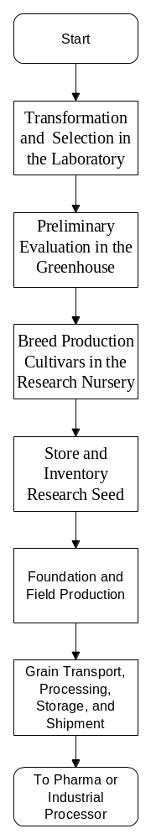
Systems description
identification of critical systems that must be defined, controlled and maintained
critical actions must be repeatable and measurable
system design must allow for changing needs
regulatory and customer requirements must be identified and incorporated into the system

Slide 14
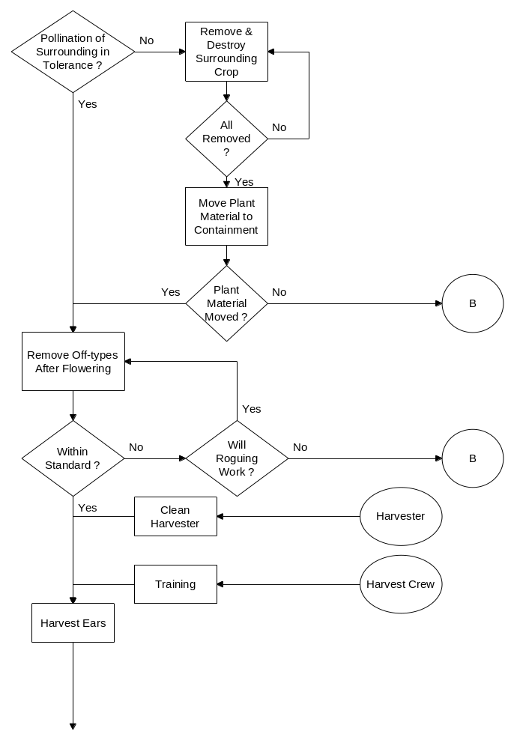
Process Management Implementation
Identify critical processes
Analyze all processes, including inputs, outputs and material that escapes
Document critical processes
Train employees and communicate expectations
Define measurement criteria
Audit the process

Slide 15
Uncertainties in confinement integrity
failure rates for process compliance
grain loss from equipment, clean out efficiencies, and recovery options
physical description of long distance pollen flow

Slide 16
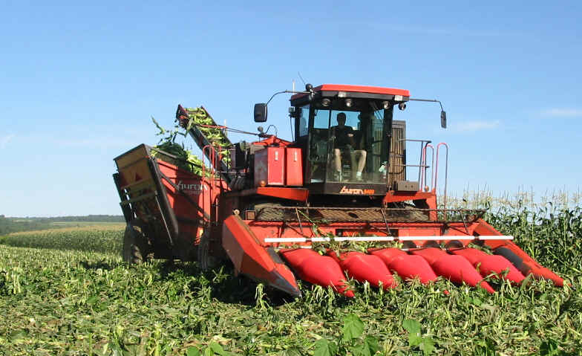
Addressing uncertainty through process design
Example: selection of equipment and harvest conditions can significantly reduce materials left in the field or intermixed with other fields

Slide 17
Addressing uncertainty through process design
Examples
  Specific local processing to channel products
  Target product expression to specific plant parts
  Design biological control mechanisms (concept redesign)

Slide 18
Implement monitor & respond strategies
Validate OC models with existing data on gene flow and representative weather
  use retrospective data to properly site and mange fields
  use prospective data to predict departures from management goals
  implement corrective actions in real time

Slide 19
Addressing uncertainty through greater knowledge of out-crossing (OC)
measure OC for seed production in Iowa
model OC with a regulatory compliant model (AERMOD) and validate result
interface model with a regional weather monitoring network
  Iowa Environmental Mesonet – IEM
develop retrospective and prospective tools for regionally based OC monitoring & prediction

Slide 20
measure OC for seed production
Data collected during a 3 year monitoring of commercial seed production fields
Out-crossing observations along in field transects
Ireland, D.S., et al: 2006. Managing Reproductive Isolation in Hybrid Seed Corn Production. Crop Science, 46, 1445-1455.

Slide 21
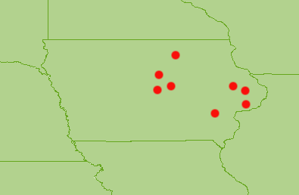
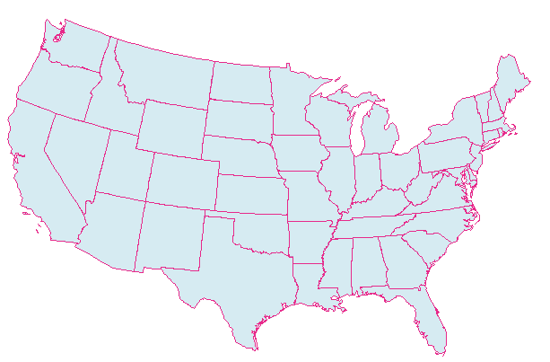
Area of Interest
Validate modelling approach using AERMOD and IEM data against an observed pollen out crossing dataset.
Selected 8 sites in Iowa from datasets with adequate meta-data

Slide 22
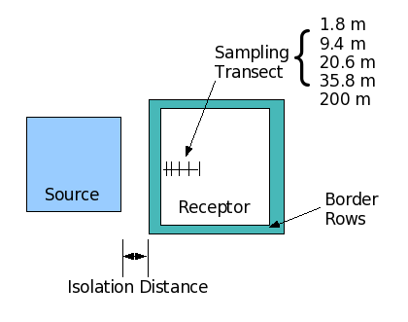
AERMOD Field Setup
Develop idealized representation of OC field studies
Use IEM weather for a “uniform domain of 49km²

Slide 23
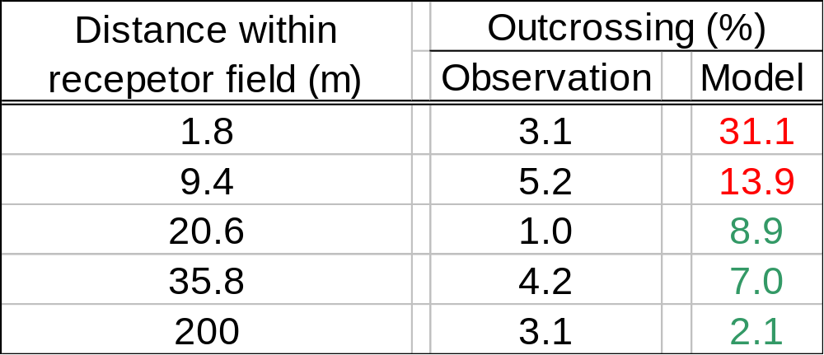
Validation – A work in progress
Field “14-29” – 130 m isolation distance
With no major modification AERMOD predicts directionally correct, order of magnitude correspondence to field observations – Thus, with further calibration AERMOD can be adapted as a first tier model

Slide 24
Regional modelling
Provide predictive and retrospective analyses of OC on a regional scale
Identify areas in Iowa that need more refined modeling and monitoring

Slide 25
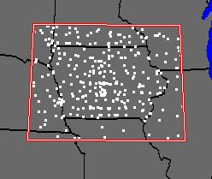
use IEM to acquire data to drive a regional pollen flow model
MESONET – a meso-scale network of weather monitoring stations
IEM collects, processes, checks, and archives environmental data produced by observation networks in the Upper Midwestern USA

Slide 26
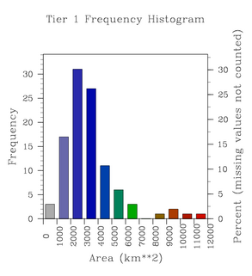
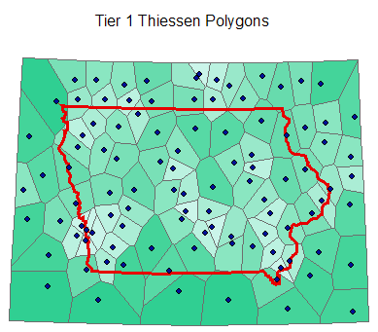
determine representativity of IEM
Polygons represent optimized areas closest to an observation point
This and further analysis allows design of a representative data grid for Iowa
Skew in polygon size indicates opportunity for improvement of regional representativity

Slide 27
link AERMOD with IEM
Same configuration as the validation runs.
Model is iterated over a 30 km grid of points covering the state to produce a representative analysis
4 runs are made for each point of the domain. The source field is rotated in 4 directions from the receptor field (N,E,S,W).

Slide 28
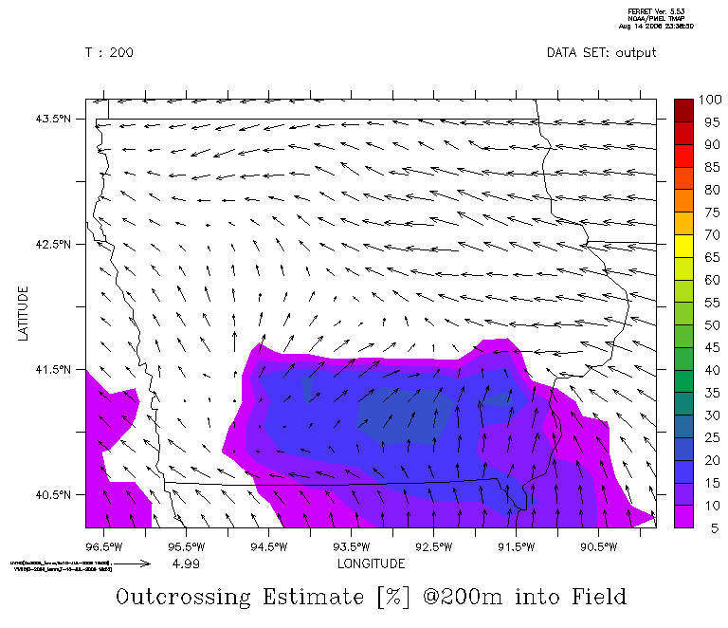
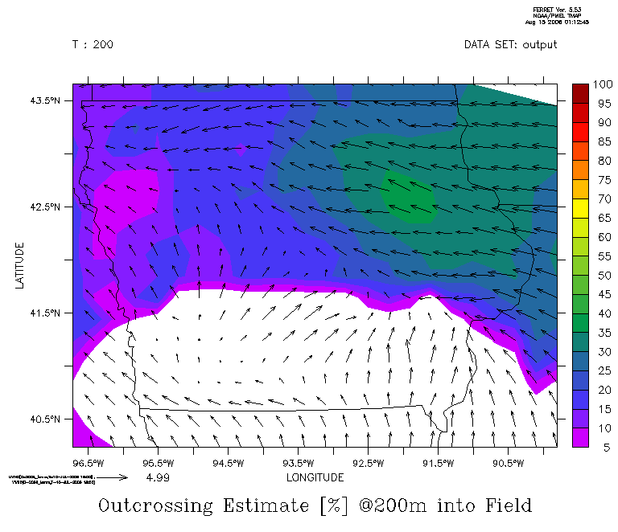
model OC with AERMOD
10 July
Source Field to West
Outcrossing estimated at 200 meters into receptor field with 130 m isolation
Vectors are mid-afternoon winds
Source Field to East

Slide 29
implement monitor & respond strategies
monitor, model, and identify departures from confinement goals in real time
identify at-risk receptor fields
segregate product from at-risk field prior to harvest (channel or destroy)
incorporate experience into process model
applicable to both confined trials & commercial deployment

Slide 30
Summary
Quantitative Exposure Assessment (QEA) provides a logical approach to address trait presence
Problem formulation and analysis of extant data usually provides sufficient rational for deployment of field trials
Residual uncertainty can be addressed through
  Gene flow studies
  Process management & design
  Monitor & respond strategies
  Concept redesign
Similar approaches may be applied to considerations of confinement and coexistence

Slide 31
Exposure Assessment and Mitigation Practices to Manage Trait Presence
Problem formulation & analysis
resolve uncertainties
high
residual
uncertainties
seek
mitigation
options
Deploy
resolve uncertainties
Conduct gene flow studies
adopt QEA approaches to identify a scope & approach to
trait presence management that is consistent with degree of uncertainty
Process management & design
Implement monitor & respond strategies
Concept redesign

Slide 32
Exposure Assessment and Mitigation Practices to Manage Trait Presence
Collaborators
  Mark Westgate (seed physiology & modeling)
  Paul Christensen (process management & design)
  Susana Goggi (seed physiology & pollen management)
  Daryl Herzmann (AERMOD and Mesonet modeling)
  Raymond Arritt (climate & modeling)
Funding
  USDA-Biotechnology Risk Assessment Grants Program
  USDA-APHIS BIGMAP
  ISU Seed Science Center
  ISU Plant Sciences Institute

